Slide 1


Predicting Airbnb Listing Price and Rating
PREDICTIVE ANALYSIS WITH MACHINE LEARNING MODELS USING AZURE ML AND SPARK ML
CIS 5560
Group 1:
Farnood Rahbar Far
Samyuktha Muralidharan
Savita Yadav
Sanjana Boddireddy
Professor: Jongwook Woo

Slide 2
Need For Predicting Airbnb Listing Price
Airbnb is a community marketplace that helps people list, discover and book unique spaces all over the world.
The objective of this project is to build a model that predicts the optimal price of a property considering the features of the listings.
As Airbnb is a marketplace, the amount a host can charge on a nightly basis is closely linked to the dynamics of the marketplace.
It helps the hosts better understand how different attributes of the listing can be used to accurately predict the price.
With better price suggestion estimates, Airbnb home providers can reach an equilibrium price that optimizes profit and affordability.

Slide 3
Need For Predicting Airbnb Property Rating
The objective is to build a model that classifies a property as highly rated or low rated based on the features of the listing.
Helps Airbnb hosts to make simple changes to the properties they are listing in order to boost customer satisfaction and attract potential bookings.
It can serve as a baseline to understand the factors that contribute to the popularity and rating of a listing.

Slide 4
Dataset Details
Dataset: Airbnb Listings, Airbnb Reviews
Total Dataset size: 4GB
Dataset Format: csv
Dataset URLs:
https://public.opendatasoft.com/explore/dataset/airbnb-listings/table/?disjunctive.host_verifications&disjunctive.amenities&disjunctive.features
https://www.kaggle.com/samyukthamurali/airbnb-ratings-dataset?select=airbnb-reviews.csv

Slide 5


Technical Specifications
Azure ML Studio
Workspace Type : Free
Workspace Storage: 10GB
Nodes : 1
Region: South Central US
Spark: Databricks Subscription
Databricks Runtime version: DBR 8.1 (includes Apache Spark 3.1.1, Scala 2.12)
Memory: 15.3 GB , 2 cores , 1 DBU, Nodes : 1
File System: DBFS (Data Bricks File System)
Python Version 3.8.6

Slide 6


Technical Specifications
Hadoop Cluster at SCU in Korea
Cluster version: Hadoop 3.1.1.3.1.4.0-315
Computing engine: Spark,
Nodes : 3
File system : Hadoop Distributed File System (HDFS)
HDFS Capacity : 11.7 TB
RAID : 24TB/18TB
PySpark:
Python version: 2.7.5
Spark version: 2.3.2.3.1.4.0-315
Apache Hive version : version 3.1.0.3.1.4.0-315
No. of CPU cores: 48
CPU Clock Speed: 842.230 MHz
Memory: 192GB

Slide 7
Machine Learning Algorithms Used
Price Prediction
Azure ML Studio:
Decision Forest Regression
Boosted Decision Tree Regression
Bayesian Linear Regression
SparkML:
Gradient Boosted Tree Regression
Decision Tree Regression
Random Forest Regression

Slide 8
Machine Learning Algorithms Used
Rating Prediction
Azure ML Studio:
Two-class Logistic Regression
Two-class Decision Forest
Two-class Boosted Decision Tree
Spark ML:
Logistic Regression
Decision Tree Classifier
Gradient Boosted Tree Classifier

Slide 9









Flowchart
Data
Evaluate
Successful Model
Feature Engineering
Prediction
Train Data
Split Dataset
Build Model
Model
Test Data

Slide 10
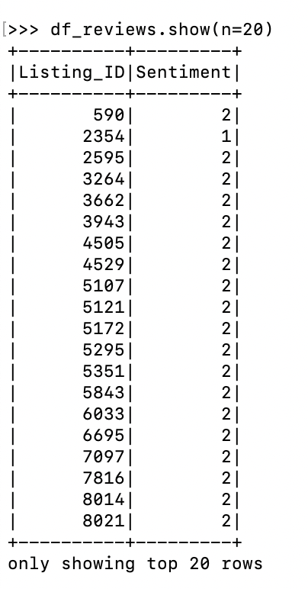
Hive Sentiment Analysis
In order to utilize the user reviews of Airbnb listings in our predictive model we performed sentiment analysis of the reviews.
The determined ‘Sentiment’ was used as one of the features in building predictive models for Airbnb Price and Rating.
2 -> Positive
1 -> Neutral
0 -> Negative

Slide 11
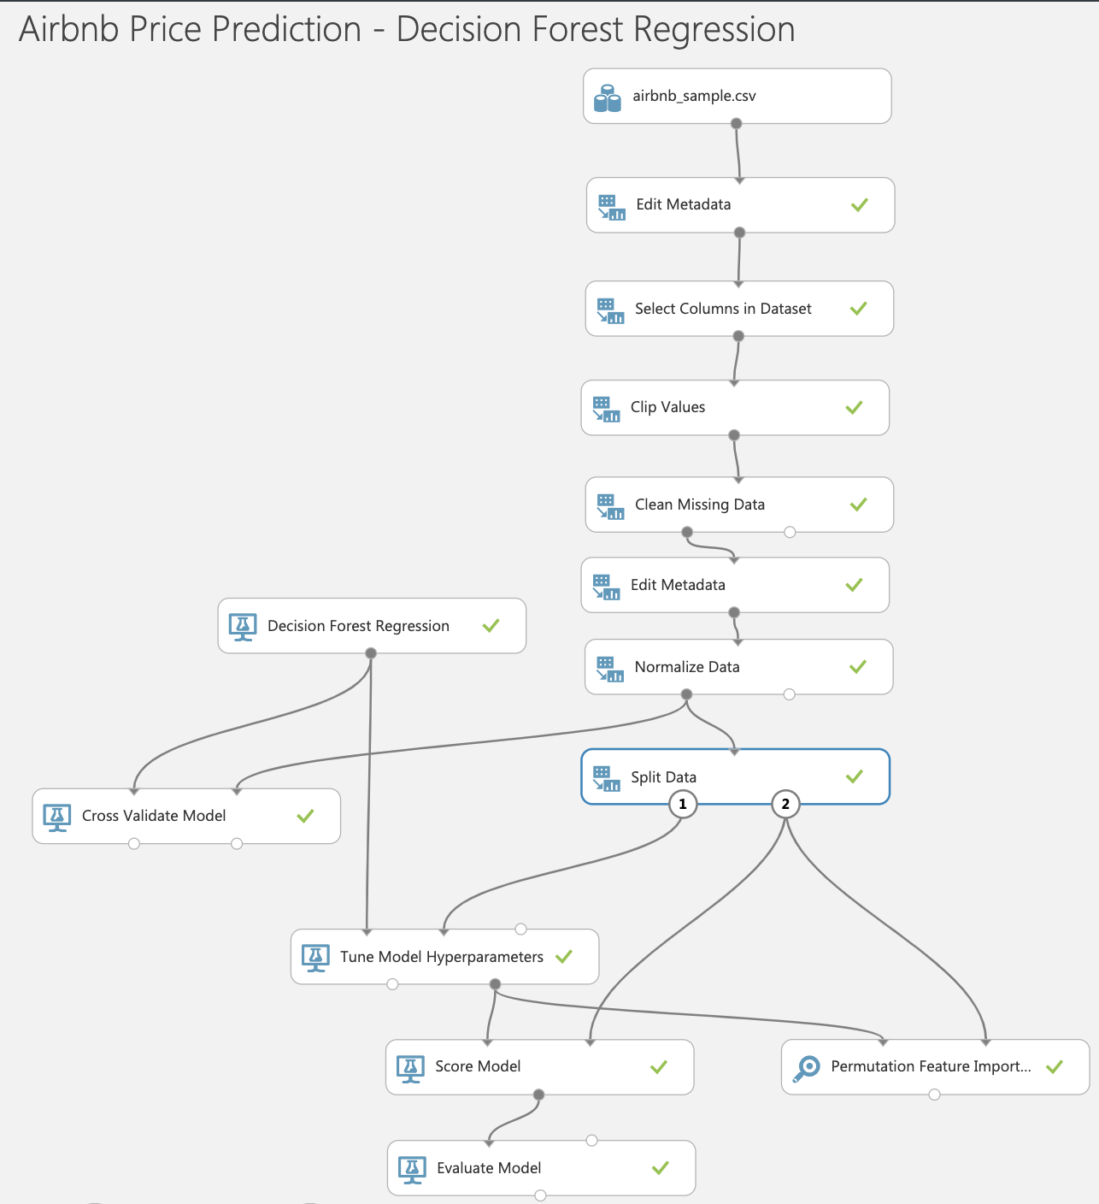
Price Prediction: Decision Forest Regression
Sampled File Size: 30 MB
Split Train/Test:70:30
Main modules:
Tune Model Hyperparameters
Permutation Feature Importance
Cross Validate Model
Time Taken to run : 1.5 minutes

Slide 12
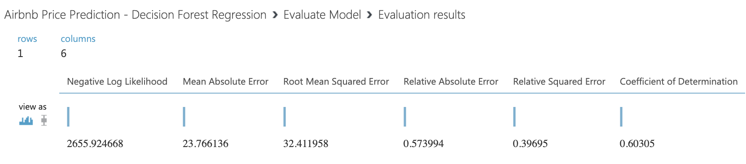
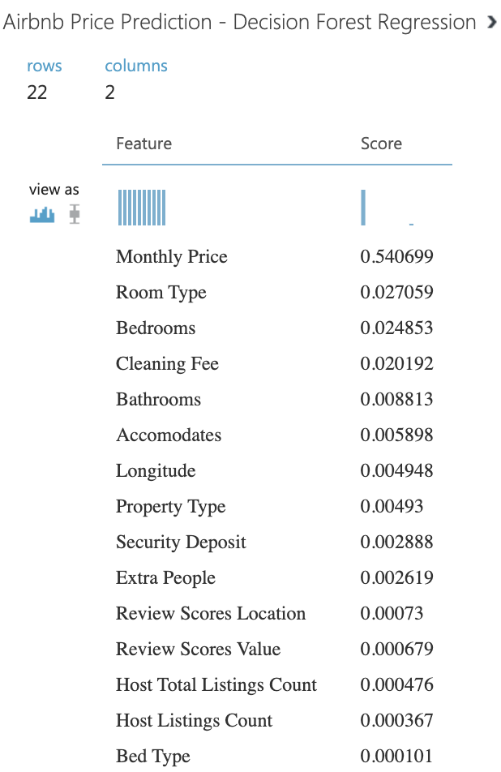




Decision Forest Regression
Evaluation Metrics
Important Features

Slide 13
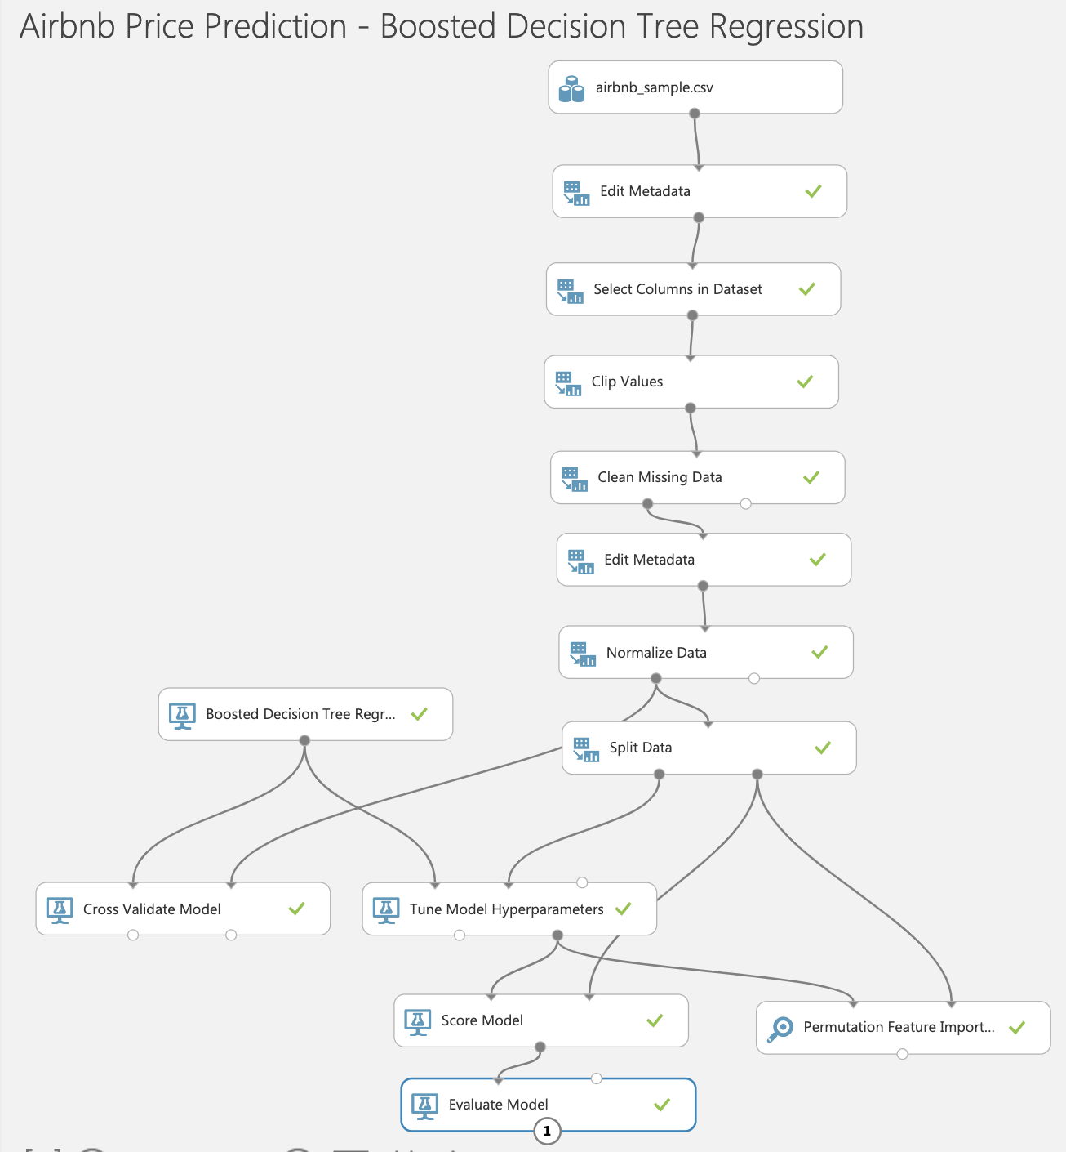
Price Prediction : Boosted Decision Tree Regression
Sampled File Size: 30 MB
Split Train/Test:70:30
Main modules
Tune Model Hyperparameters
Permutation Feature Importance
Cross Validate Model
Time Taken to run : 3 minutes

Slide 14
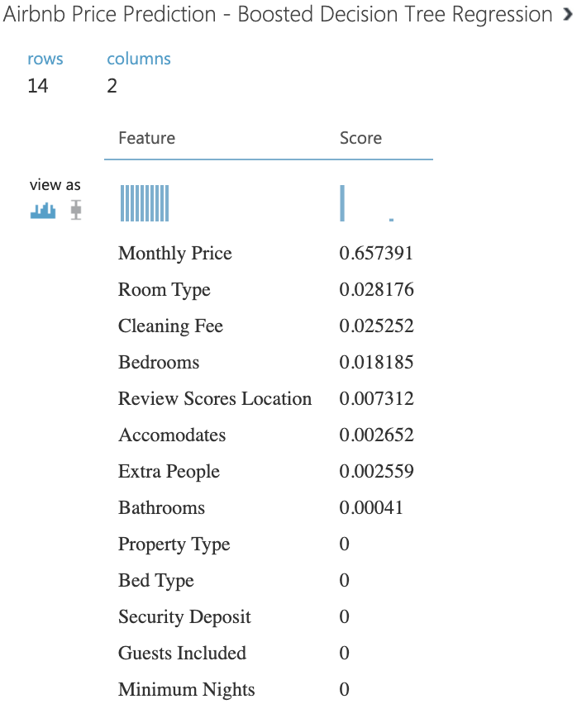
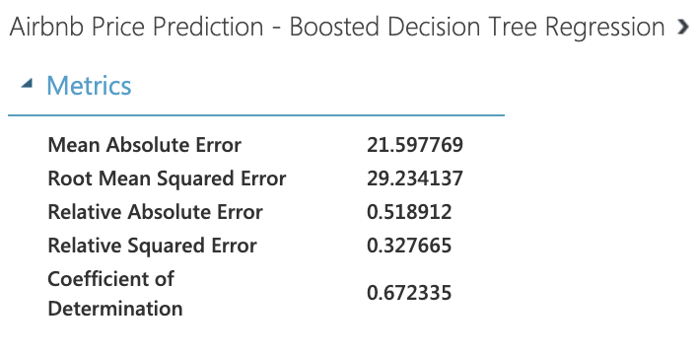






Boosted Decision Tree Regression
Important Features Evaluation Metrics
Lesser RMSE and better Co-efficient of Determination than Decision Forest Regression

Slide 15
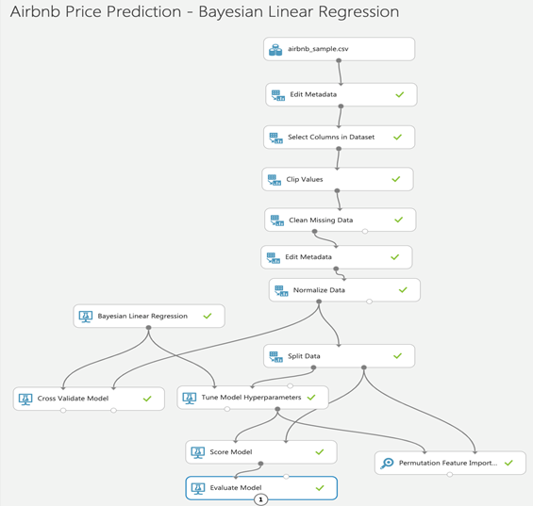
Price Prediction : Bayesian Linear Regression
Sampled File Size: 30 MB
Split Train/Test:70:30
Main modules
Tune Model Hyperparameters
Permutation Feature Importance
Cross Validate Model
Time Taken to run : 2 minutes

Slide 16
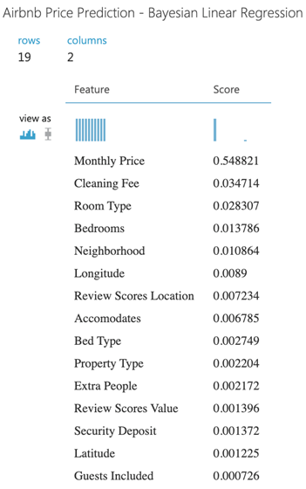
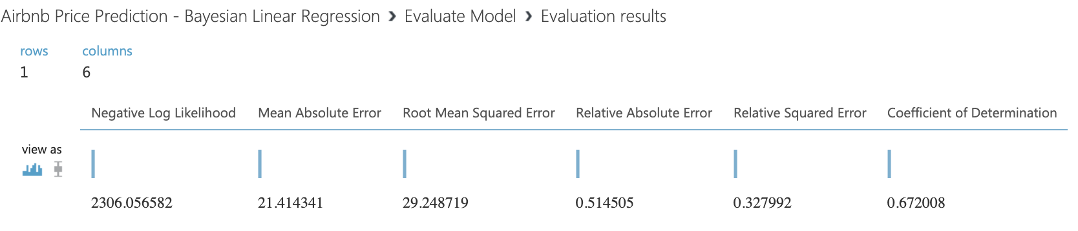










Bayesian Linear Regression
Evaluation Metrics
Important Features
Similar results to Boosted Decision Tree Regression

Slide 17
AzureML Results Comparison
 | Decision Forest Regression | Boosted Decision Tree Regression | Bayesian Linear Regression
Mean Absolute Error | 23.766136 | 21.597769 | 21.414341
Root Mean Squared Error | 32.411958 | 29.234137 | 29.248719
Relative Absolute Error | 0.573994 | 0.518912 | 0.514505
Relative Squared Error | 0.39695 | 0.327665 | 0.327992
Coefficient of Determination | 0.60305 | 0.672335 | 0.672008

Slide 18
Main factors affecting the price of Airbnb Listings
Room Type
Cleaning Fee
Bedrooms
Accommodates
Extra People
Property Type
Security Deposit
Review Scores Location
Bed Type

Slide 19


Price Prediction SparkML – Databricks

Slide 20
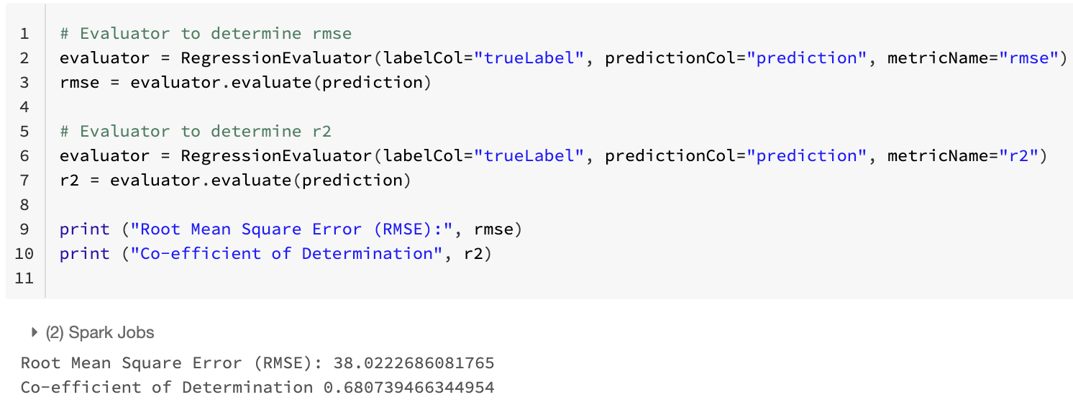
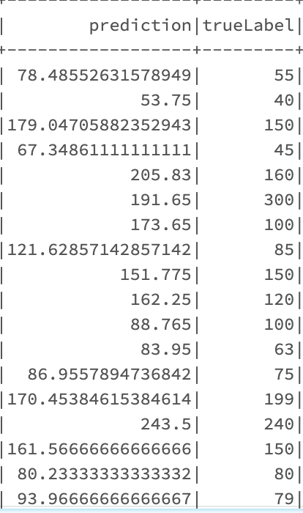







Price prediction: Random Forest Regression
Sampled File Size: 30 MB
Split Train/Test: 70:30
Time Taken to run : 60 minutes
RMSE: 38.02226
R2: 0.680739

Slide 21
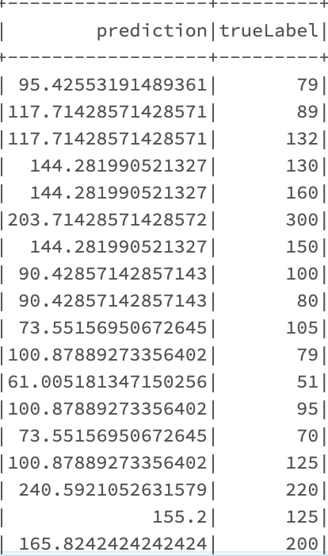
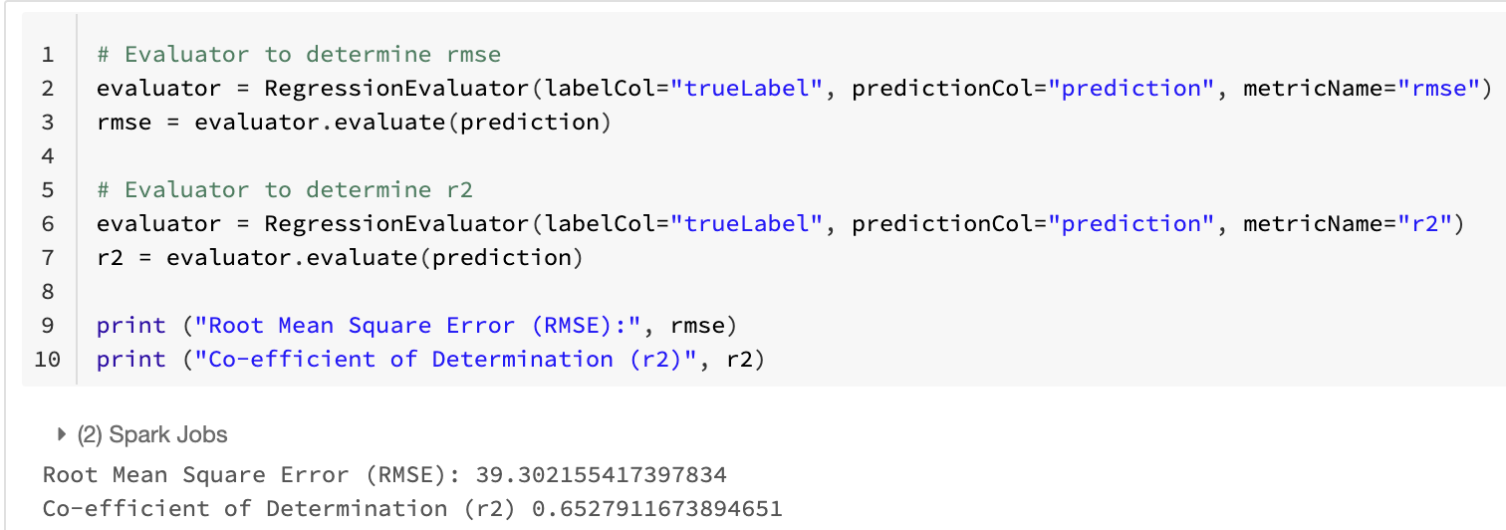





Price prediction: Decision Tree Regression
Sampled File Size: 30 MB
Split Train/Test: 70:30
Time Taken to run : 15 minutes
RMSE : 39.302155
R2: 0.652791

Slide 22
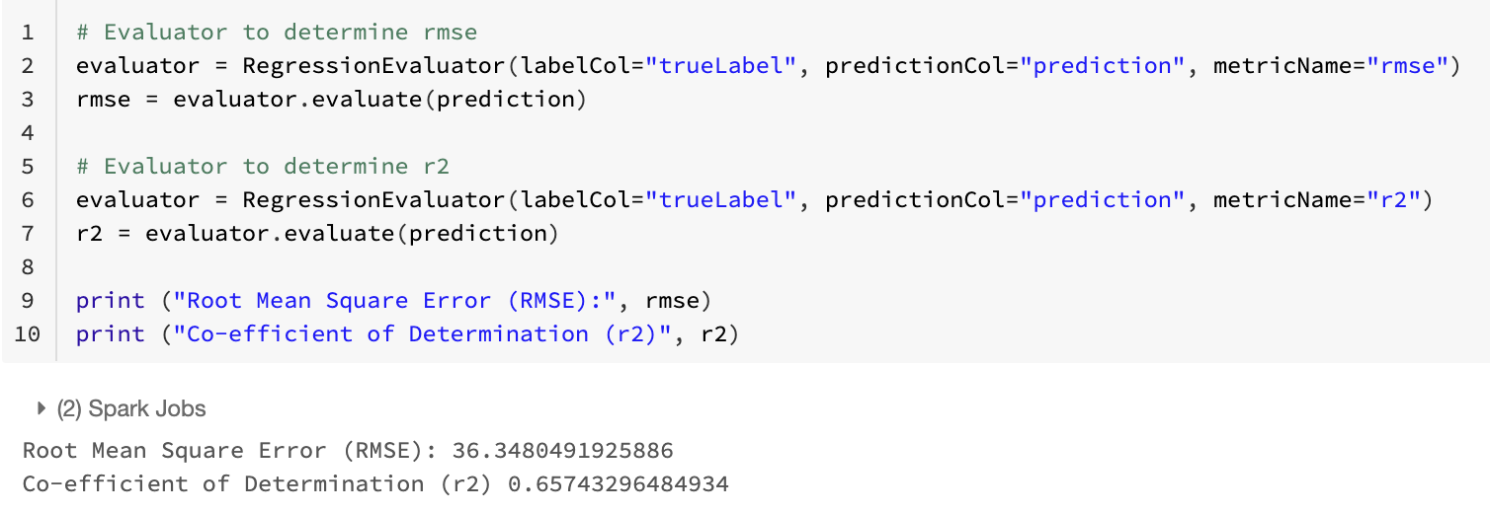
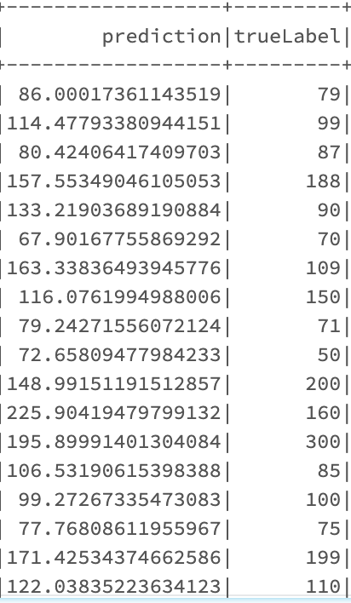





Price Prediction: Gradient Boosted Tree Regression
Sampled File Size: 30 MB
Split Train/Test: 70:30
Time Taken to run : 40 minutes
RMSE : 36.34804
R2: 0.657432

Slide 23
Comparison of Results of SparkML Algorithms
 | Decision Tree Regression | Gradient Boosted Tree Regressor | Random Forest Regressor
Root Mean Squared Error | 39.30215 | 36.34804 | 38.02226
Coefficient of Determination | 0.652791 | 0.657432 | 0.680739
Time taken to run | 10 minutes | 40 minutes | 60 minutes

Slide 24
Databricks vs Hadoop Cluster
Databricks ( 1 node) | Decision Tree Regressor | Gradient Boosted Tree Regressor | Random Forest Regressor
Root Mean Squared Error | 39.302155 | 36.34804 | 38.02226
Coefficient of Determination | 0.652791 | 0.657432 | 0.680739
Time taken to run | 15 minutes | 40 minutes | 60 minutes
Hadoop Cluster ( 3 nodes)
Root Mean Squared Error | 37.550365 | 37.760964 | 36.154873
Coefficient of Determination | 0.6618076 | 0.6726220 | 0.691347
Time taken to run | 5 minutes | 25 minutes | 10 minutes

Slide 25
Airbnb Rating Prediction
Predicting whether the listing has a good rating or not.
Converting the Review Scores Rating column to categorical
Review Scores Rating >= 80 -> High Rating
Review Scores Rating < 80 -> Low Rating
Using two-class classification algorithms to build a model to classify the listings as high rated and low rated, based on the features of the listing.

Slide 26
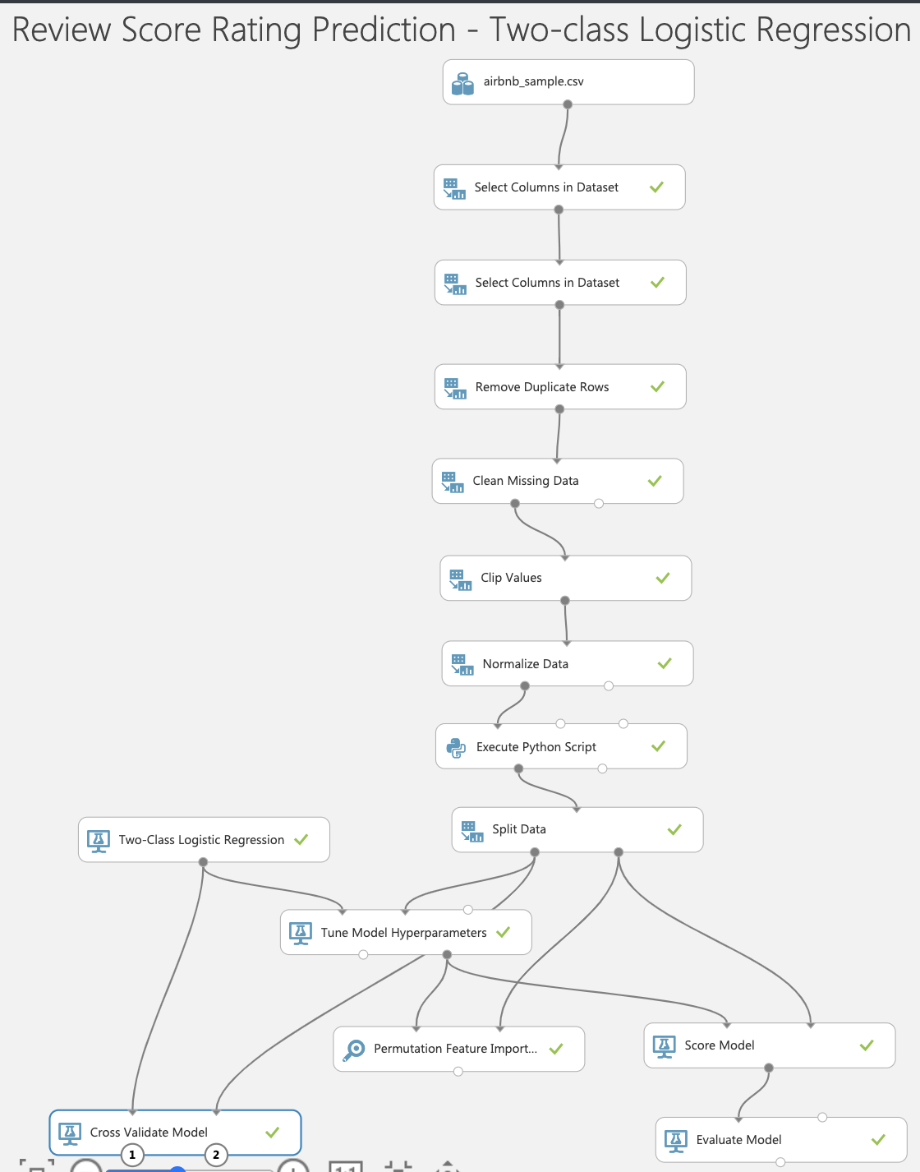
Rating Prediction-Two-class Logistic Regression
File Size: 30 MB
Split Train/Test: 50:50
Main modules
Tune Model Hyperparameters
Permutation Feature Importance
Cross Validate
Time Taken to run : 6 minutes

Slide 27
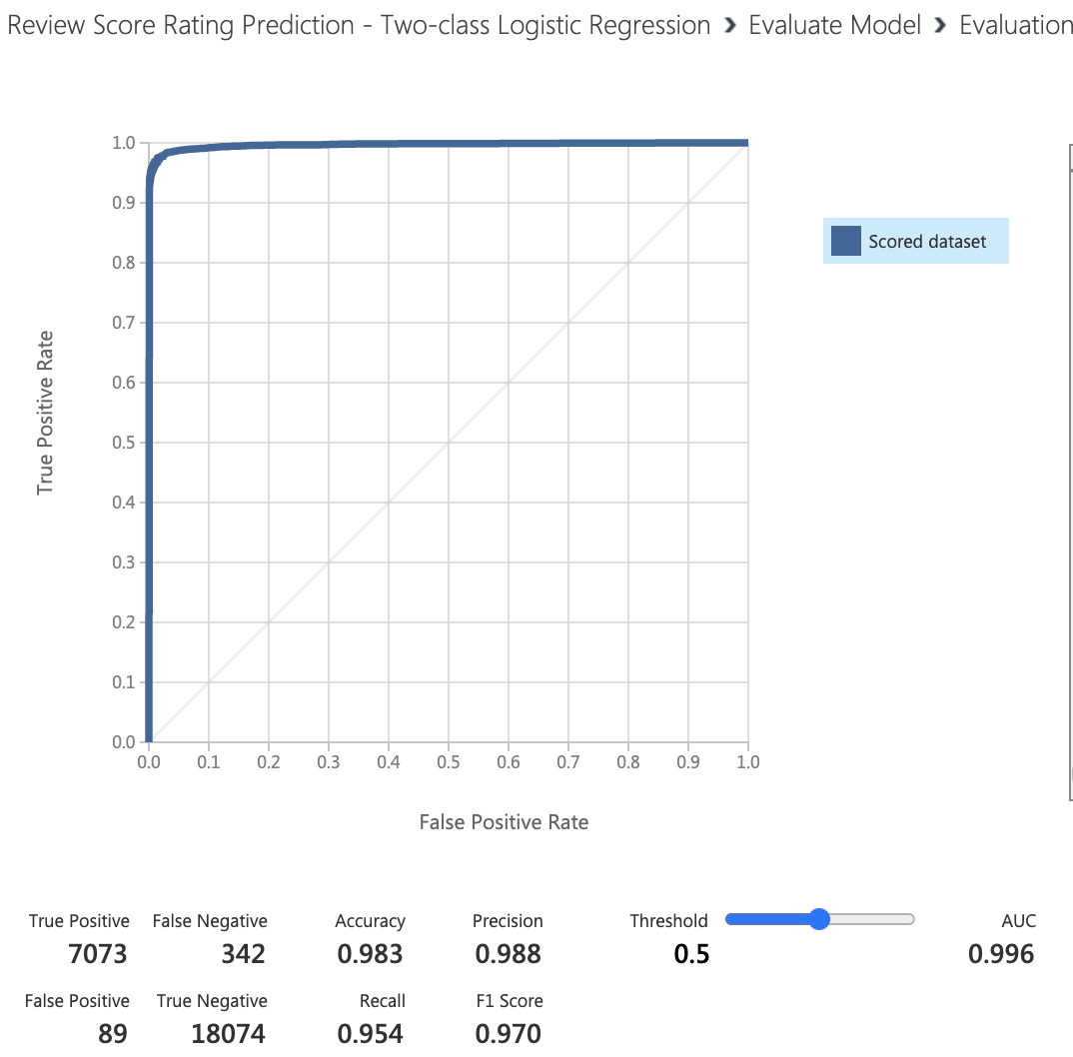
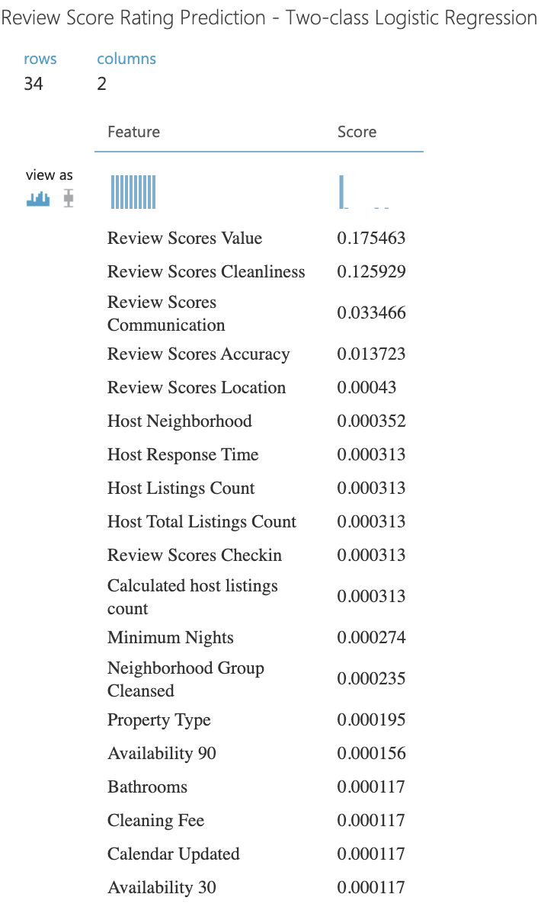




Two-class Logistic Regression
Evaluation Metrics Important Features

Slide 28
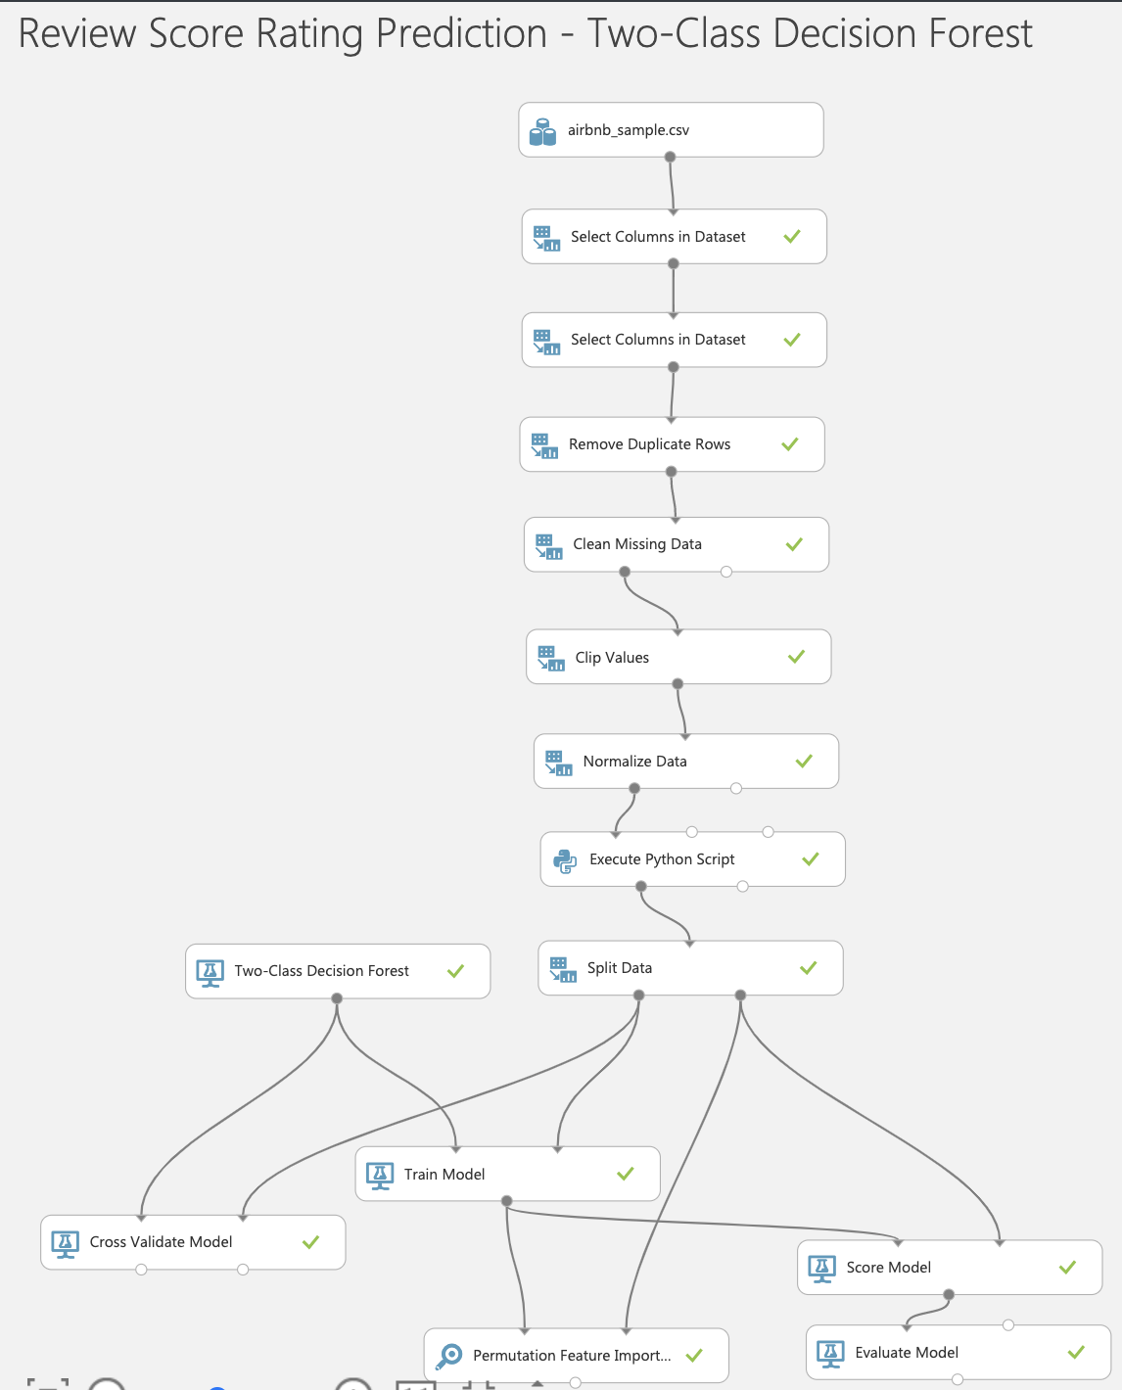
Rating Prediction–Two-class Decision Forest
File Size: 30 MB
Split Train/Test: 50:50
Main modules
Permutation Feature Importance
Cross Validate
Time Taken to run : 4 minutes

Slide 29
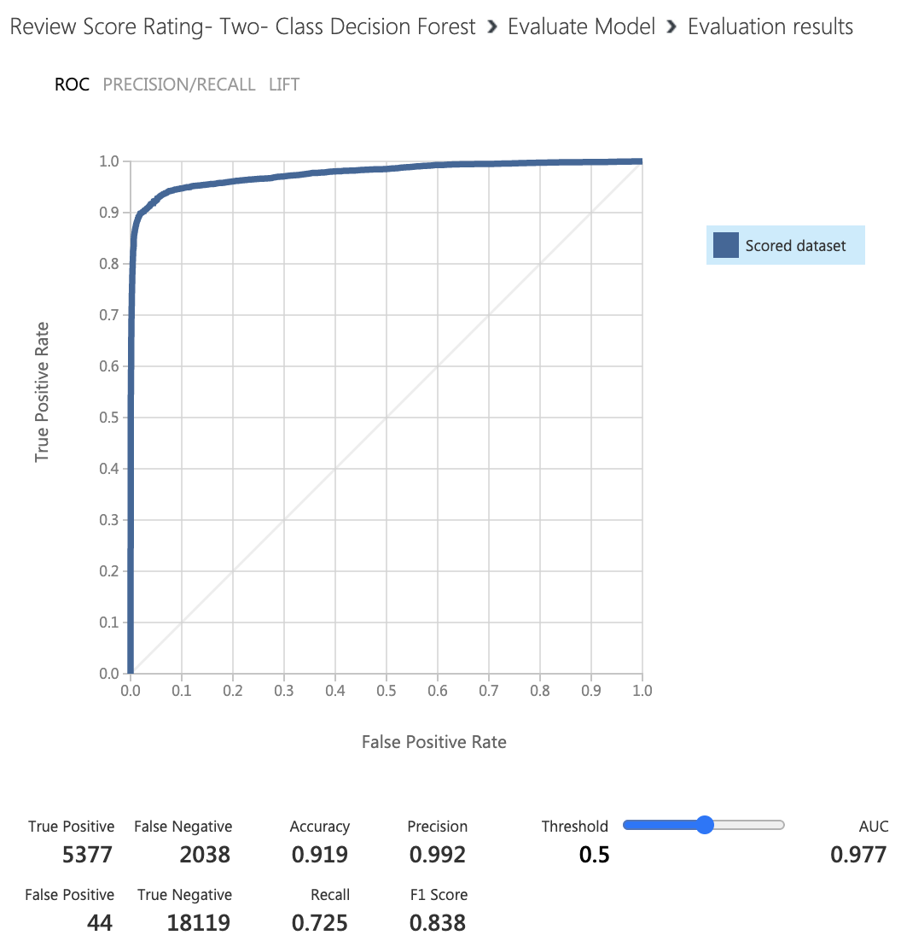
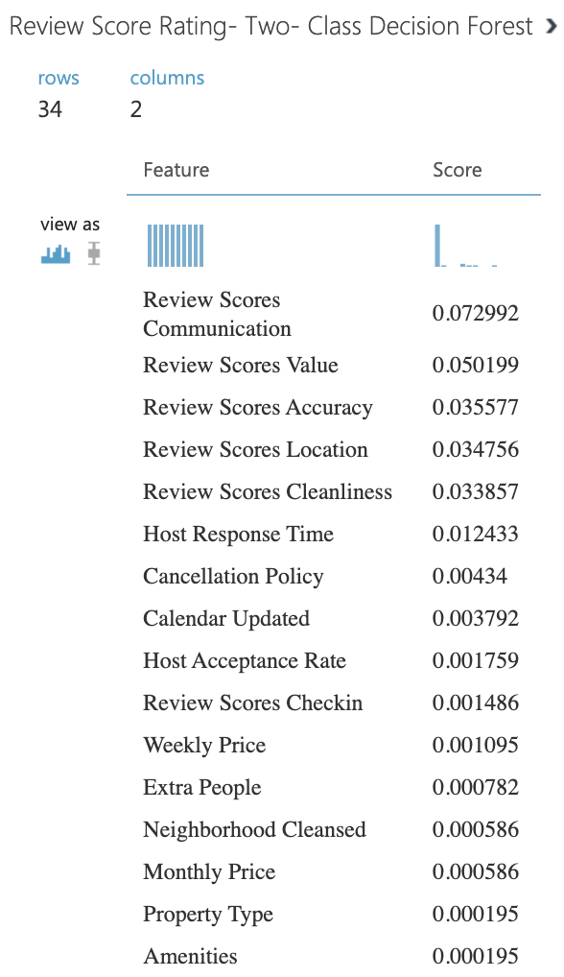



Two-class Decision Forest
Evaluation Metrics Important Features

Slide 30
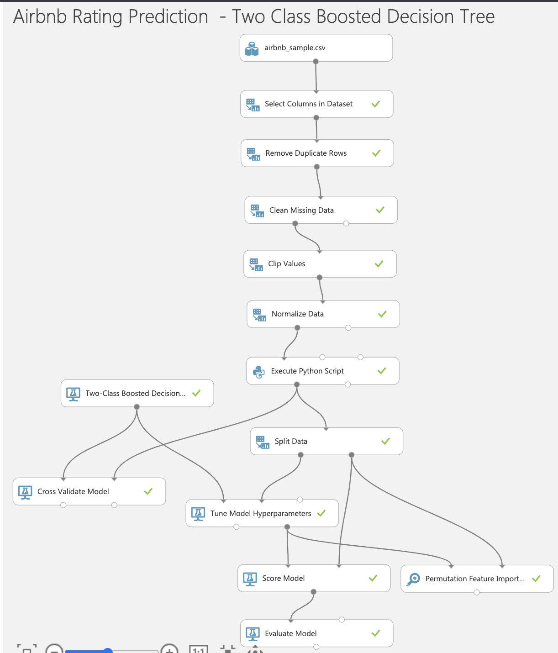
Rating Prediction –Two-class Boosted Decision Tree
File Size: 30 MB
Split Train/Test: 50:50
Main modules
Tune Model Hyperparameters
Permutation Feature Importance
Cross Validate
Time Taken to run : 45 minutes

Slide 31
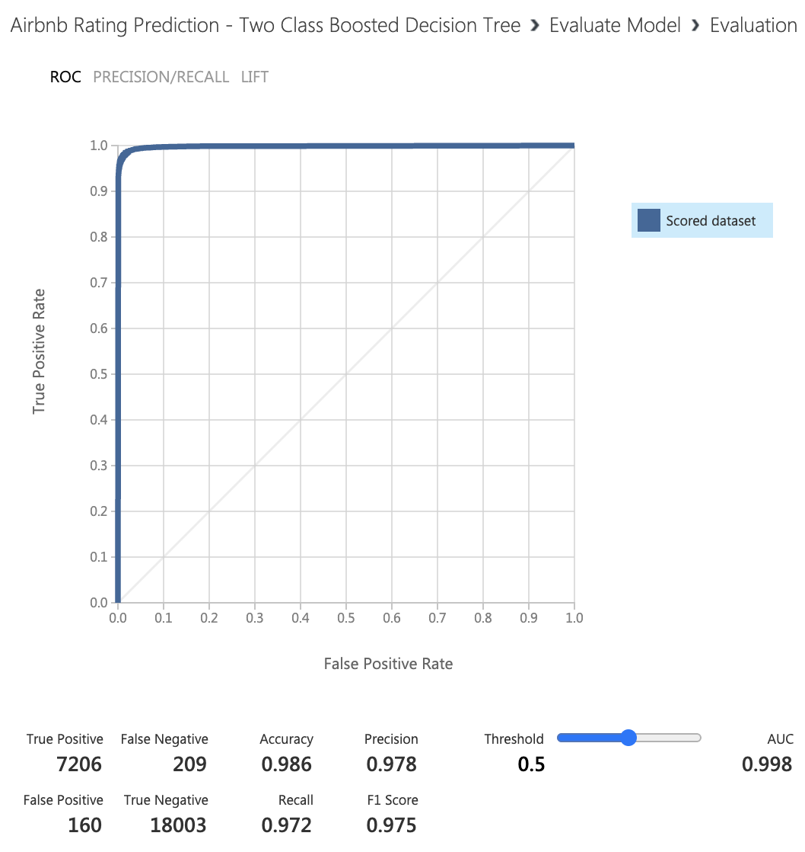
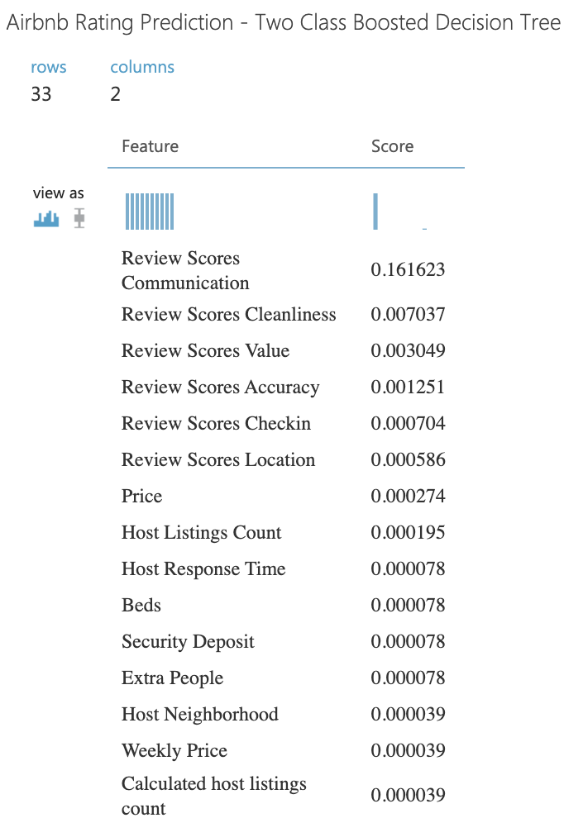








Two-class Boosted Decision Tree
Evaluation Metrics Important Features

Slide 32
AzureML Results Comparison
 | TWO-CLASS DECISION FOREST | TWO-CLASS Boosted DECISION Tree | Two-Class Logistic Regression
AUC | 0.977 | 0.998 | 0.996
PRECISION | 0.992 | 0.978 | 0.988
RECALL | 0.725 | 0.972 | 0.954
Accuracy | 0.919 | 0.986 | 0.983
F1 Score | 0.838 | 0.975 | 0.970

Slide 33
Main factors affecting the Rating of Airbnb Listings
Review Scores Communication
Review Scores Cleanliness
Review Scores Value
Review Scores Accuracy
Host Neighborhood
Host Response Time
Host Listings Count
Beds
Availability 90
Price

Slide 34
Rating Prediction SparkML – Databricks

Slide 35
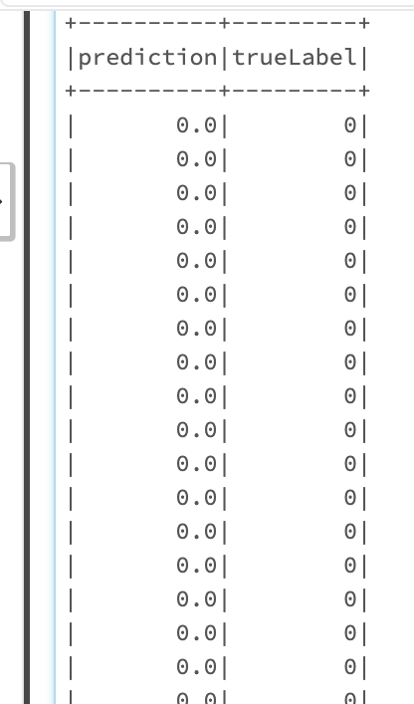
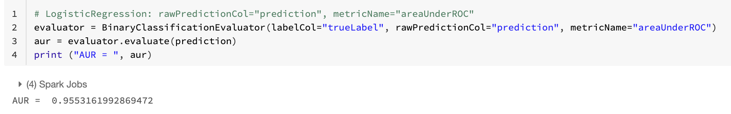
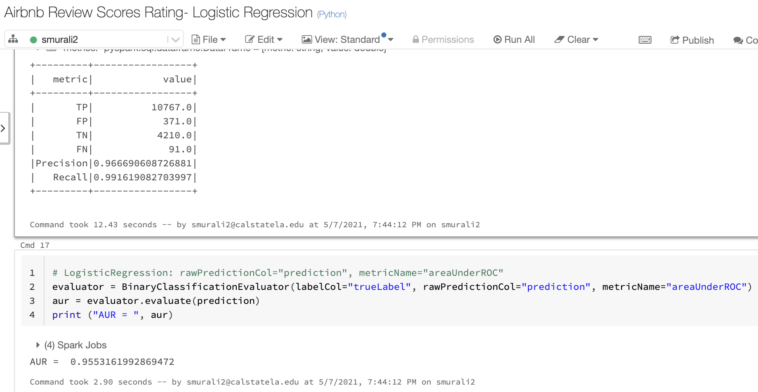








Logistic Regression
Sampled File Size: 30 MB
Split Train/Test: 70:30
Time Taken to run : 15 minutes
AUC : 0.9553161
Precision: 0.966690
Recall: 0.991619

Slide 36
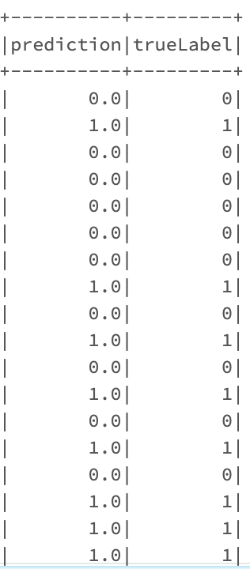
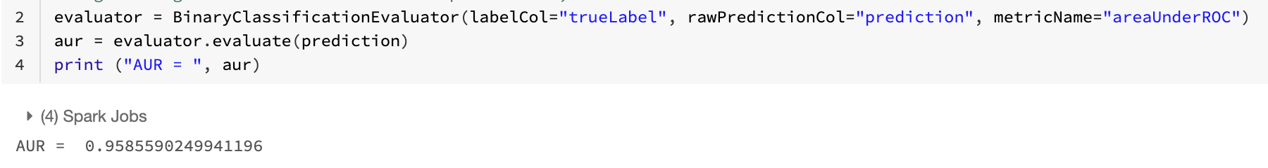
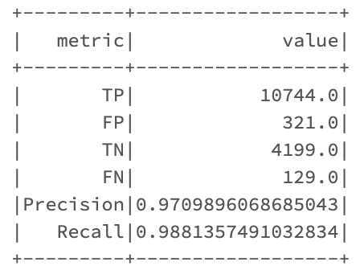







Decision Tree Classifier
Sampled File Size: 30 MB
Split Train/Test: 70:30
Time Taken to run : 25 minutes
AUC : 0.9585590
Precision: 0.970989
Recall: 0.988135

Slide 37
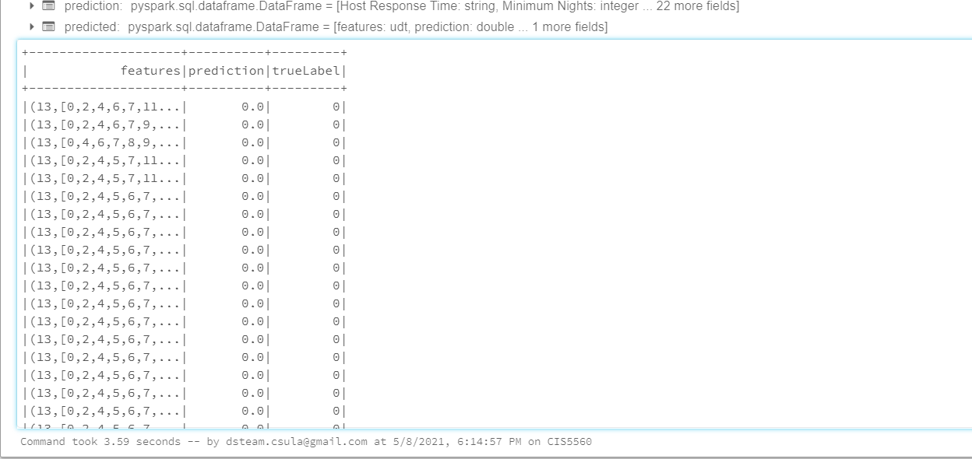
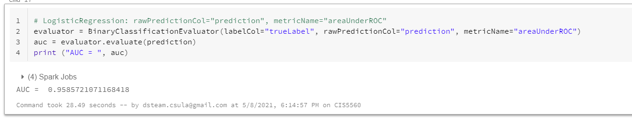
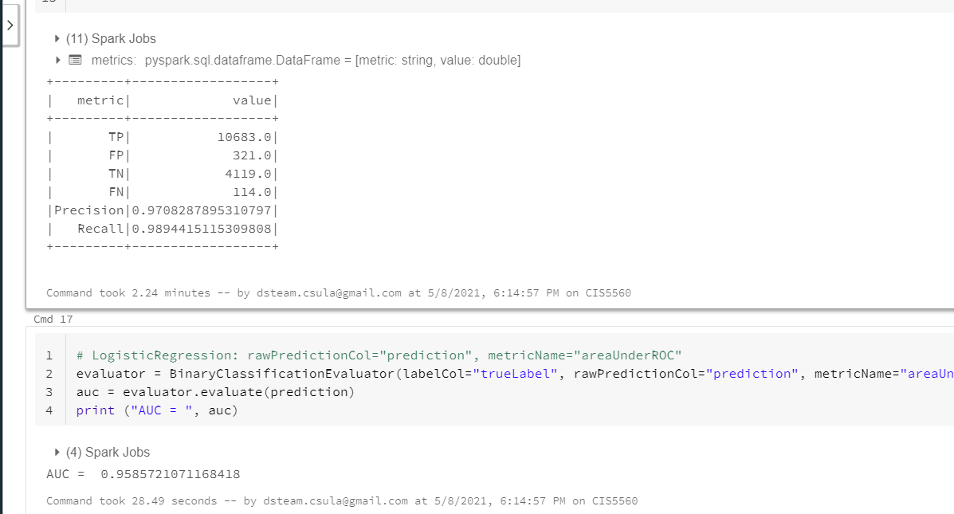




Gradient Boosted Tree Classifier
Sampled File Size: 30 MB
Split Train/Test: 70:30
Time Taken to run : 30 minutes
AUC : 0.9585721
Precision: 0.970828
Recall: 0.98944

Slide 38
Comparison of results of SparkML Algorithms
 | Logistic Regression | Decision Tree Classifier | Gradient Boosted Tree Classifier
AUC | 0.9553161 | 0.9585590 | 0.9585721
PRECISION | 0.966690 | 0.970989 | 0.970828
RECALL | 0.991619 | 0.988135 | 0.98944
Time taken to run | 15 minutes | 25 minutes | 30 minutes

Slide 39
Databricks vs Hadoop Cluster
Databricks ( 1 node) | Logistic Regression | Decision Tree Classifier | Gradient Boosted Tree Classifier
AUC | 0.9553161 | 0.9585590 | 0.9585721
Precision/Recall | 0.966690/ 0.991619 | 0.970989/ 0.988135 | 0.970828/0.98944
Time taken to run | 15 minutes | 25 minutes | 30 minutes
Hadoop Cluster ( 3 nodes)
AUC | 0.9504987 | 0.9590108 | 0.955631
Precision/Recall | 0.9638829/0.9900703 | 0.9702456/ 0.9899571 | 0.9692927/0.988090
Time taken to run | 6 minutes | 7 minutes | 60 minutes

Slide 40
GitHub URL
https://github.com/SYSavy/CIS-5560

Slide 41
References
How to choose algorithms for Microsoft Azure Machine Learning https://docs.microsoft.com/en-us/azure/machinelearning/machine- learning-algorithm-choice
Regression Analysis Essentials for Machine Learning http://www.sthda.com/english/wiki/regression-analysis-essentials-for-machine-learning
Discover Feature Engineering, How to Engineer Features and How to Get Good at It: https://machinelearningmastery.com/discover-feature-engineering-how-to-engineer-features-and-how-to-get-good-at-it/

Slide 42


